Slide 1
keyloggers
CAPSTONE PROJECT
Presented By:
1. Claflin C R -Dmi College of Engineering-CSE

Slide 2
OUTLINE
Problem Statement
Proposed Solution
System Development Approach
Algorithm & Deployment
Result
Conclusion
Future Scope
References

Slide 3
Problem Statement
In an increasingly digital world, where security and accountability are paramount, there's a growing necessity for unobtrusive monitoring of keyboard activity. For instance, parents may seek to oversee their children's online activities, while employers may require monitoring of employee computer usage. To address this need, the objective is to develop a Python-Tkinter based keylogger application. This tool will discreetly capture keyboard events such as key presses, releases, and holds, operating seamlessly in the background. It will offer real-time logging and the option to save data in text (.txt) and JSON (.json) formats. The goal is to provide a straightforward yet effective solution for tracking keyboard activity, aiding in scenarios like parental oversight and employee management.

Slide 4
Proposed Solution
To fulfill the need for discreet keyboard activity monitoring in today's digitally driven environment, we propose the development of a Python-Tkinter based keylogger application and the features include:
Comprehensive Event Capture: The keylogger will seamlessly capture various keyboard events, including key presses, releases, and holds, ensuring thorough monitoring of user activity.
Real-time Logging: Offering real-time logging capabilities, the keylogger will provide instant visibility into keyboard activity, allowing parents and employers to stay informed.
Flexible Data Saving Options: Users will have the flexibility to save recorded keystrokes in both text (.txt) and JSON (.json) formats, enhancing compatibility and ease of analysis.

Slide 5
System Approach
The following is the development approach for the new keylogger:
Requirement Analysis: Understand stakeholder needs, such as parents and employers,
and define keylogger requirements.
Design: Develop the keylogger's functionalities, user interface, and data handling mechanisms.
Implementation: Code the keylogger using Python and Tkinter, and conduct rigorous testing.
Deployment: Create installation packages, configure settings, and provide comprehensive
documentation.
Maintenance: Monitor performance, provide updates, offer user support, and ensure adherence
to ethical standards and regulations.

Slide 6
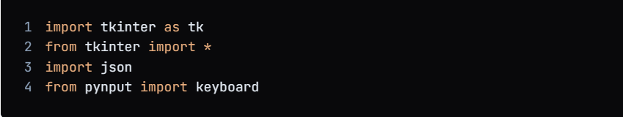
Algorithm & Deployment
1.Import the necessary libraries:

Slide 7
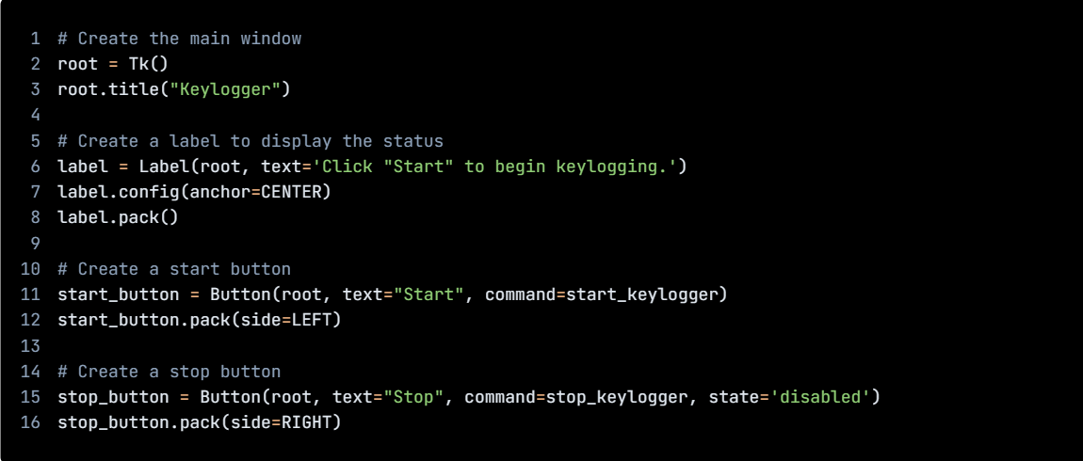
Algorithm & Deployment
1.Create GUI

Slide 8
Algorithm & Deployment
1.Import the necessary libraries:
# Initialize the variables
keys_used = []
flag = False
keys = ""
# Define the on_press function
def on_press(key):
global flag, keys_used, keys
if flag == False:
keys_used.append(
{'Pressed': f'{key}'}
)
flag = True
if flag == True:
keys_used.append(
{'Held': f'{key}'}
)

Slide 9
Algorithm & Deployment
1.Import the necessary libraries:
# Define the on_release function
def on_release(key):
global flag, keys_used, keys
keys_used.append(
{'Released': f'{key}'}
)
if flag == True:
flag = False
keys = keys + str(key)
# Define the generate_json_file function
def generate_json_file(keys_used):
with open('key_log.json', '+wb') as key_log:
key_list_bytes = json.dumps(keys_used).encode()
key_log.write(key_list_bytes)

Slide 10
Algorithm & Deployment
1.Import the necessary libraries:
# Define the start_keylogger function
def start_keylogger():
global listener
listener = keyboard.Listener(on_press=on_press, on_release=on_release)
listener.start()
label.config(text="[+] Keylogger is running!\n[!] Saving the keys in 'keylogger.txt'")
start_button.config(state='disabled')
stop_button.config(state='normal')
# Define the stop_keylogger function
def stop_keylogger():
global listener
listener.stop()
label.config(text="Keylogger stopped.")
start_button

Slide 11
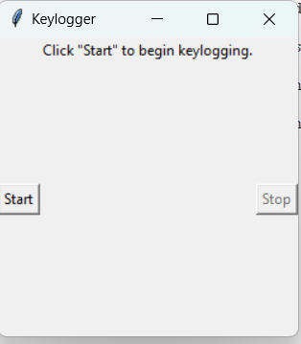
Result

Slide 12

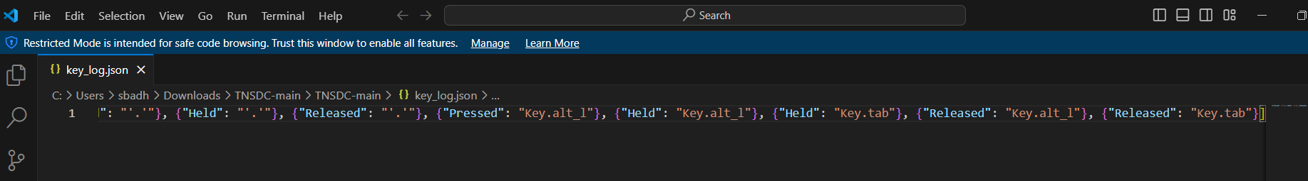
Result

Slide 13
Conclusion
The Python-Tkinter keylogger application discreetly monitors keyboard activity, addressing the increasing demand for unobtrusive digital surveillance.
Through real-time logging and flexible data saving options, it offers comprehensive monitoring capabilities, catering to the needs of parents overseeing children's online activities and employers managing computer usage.
With its user-friendly interface and ethical considerations, the keylogger system provides a straightforward yet effective solution for tracking keyboard activity, enhancing security and accountability in digital environments.

Slide 14
Future scope
Advanced Data Analysis: Implement advanced data analysis techniques, such as natural language processing, sentiment analysis, and behavior pattern recognition, to extract valuable insights from the recorded keyboard activity, enabling deeper understanding of user behavior and intentions.
Integration with Security Systems: Integrate the keylogger application with existing security systems and tools, such as intrusion detection systems and antivirus software, to enhance overall cybersecurity measures by providing additional layers of monitoring and threat detection.
Remote Monitoring and Management: Develop remote monitoring and management capabilities, allowing administrators to monitor keyboard activity and manage keylogger settings remotely, enabling efficient oversight and control of multiple devices from a centralized location.
User Customization: Provide users with extensive customization options, allowing them to tailor the keylogger's settings and functionalities according to their specific monitoring needs and preferences, enhancing flexibility and user satisfaction.

Slide 15
References
1. https://github.com/techtrainer20/TNSDC
2.https://www.bing.com/ck/a?!&&p=1f4ad54fbd8b6758JmltdHM9MTcxMTg0MzIwMCZpZ3VpZD0wY2FkZjU2My03YjRjLTZiMTctMzU4Ny1lNmJmN2E5ZTZhOTcmaW5zaWQ9NTUyOA&ptn=3&ver=2&hsh=3&fclid=0cadf563-7b4c-6b17-3587-e6bf7a9e6a97&psq=keyloggrs&u=a1aHR0cHM6Ly93d3cuZ2Vla3Nmb3JnZWVrcy5vcmcvaW50cm9kdWN0aW9uLXRvLWtleWxvZ2dlcnMv&ntb=1

Slide 16
THANK YOU

